Slide 1

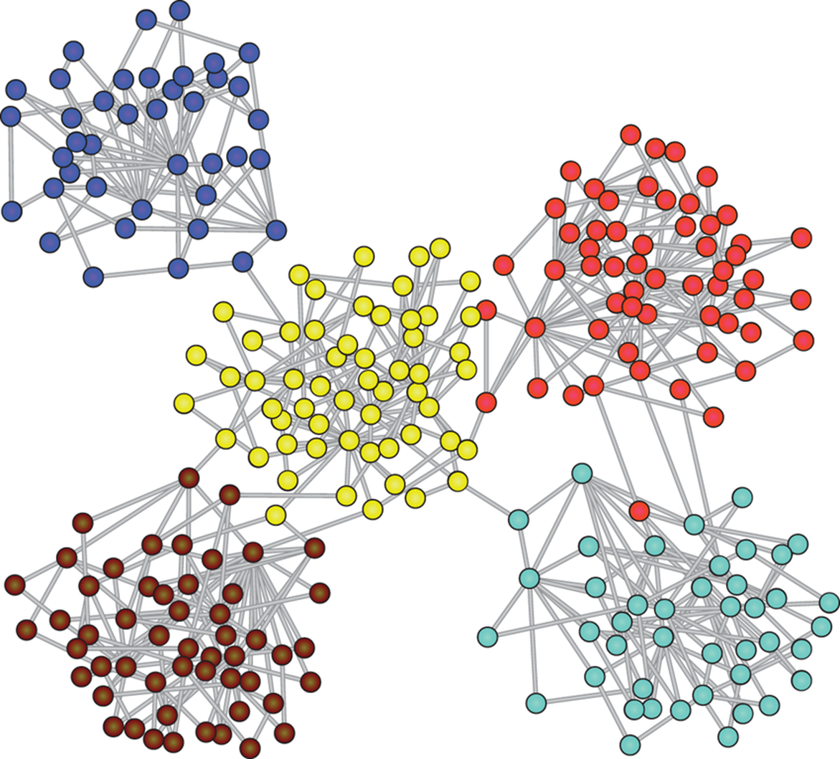
Capstone Project Phase A: Graph Generation using Graph U-Nets 24-1-R-4
Supervisors: Dr. Renata Avros | Prof. Zeev Volkovich
Yana Raitsin | Hanil Zarbailov

Slide 2
Agenda
The Project's Goals
Graph U-Nets
Misc-GAN
The Project Solution

Slide 3
The Project's Goals: The Problem
The Problem with the Misc-GAN model:
Has limitations in graph generation precision
Doesn't use node features for generating synthetic graphs
"Multi-Scale Graph Representation Module" has limitations in efficiency and precision

Slide 4
The Project's Goals: Need For The Project
Improving upon Misc-GAN's efficiency and precision
Improving "Multi-Scale Graph Representation Module" of Misc-GAN
Enhanced performance in complex graph data analysis

Slide 5
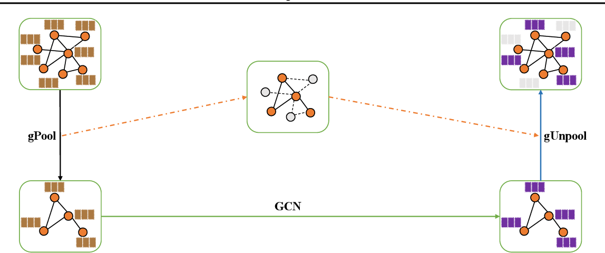
Graph U-Nets
An adaption of U-Net architecture for graph-structured data.
Key Components:
Graph Convolutional Layers: Perform convolution operations on graphs to capture local structures.
Pooling and Unpooling Layers: Coarsen and reconstruct graphs, preserving essential structures.
Skip Connections: Retain important features and improve gradient flow by connecting downsampling and upsampling paths.

Slide 6
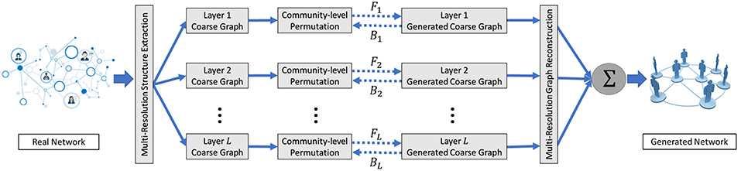
Misc-GAN
Sophisticated graph generation model
Captures complex relationships and hierarchies
The architecture:
Multi-Scale Graph Representation Module
Graph Generation Module
Graph Reconstruction Module

Slide 7
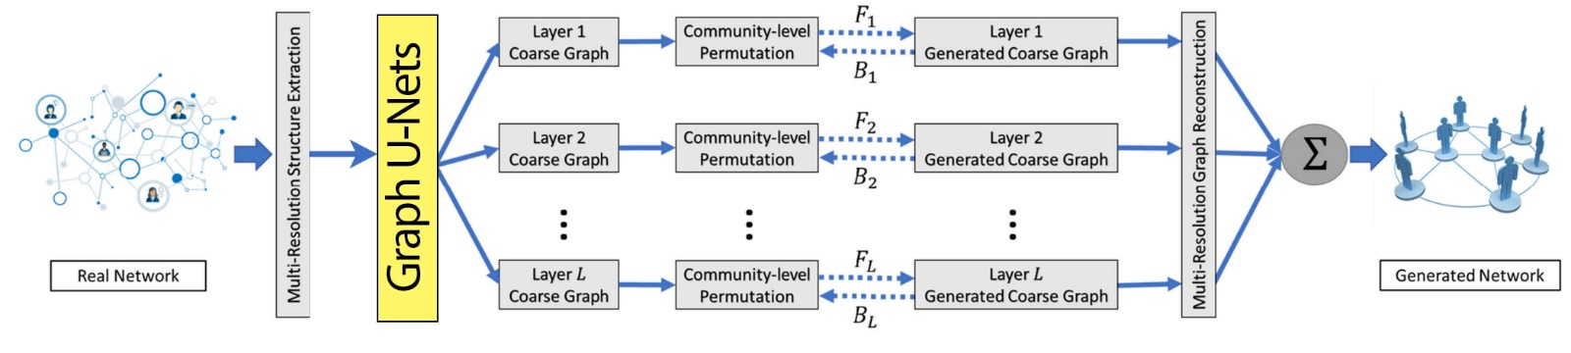
The Project Solution: Architecture

Slide 8
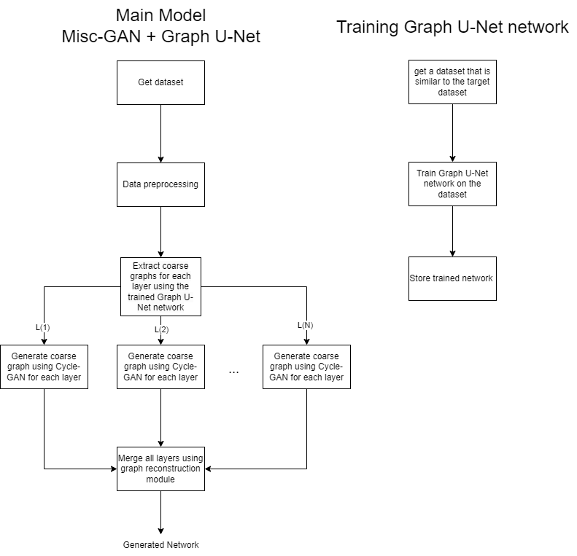
The Project Solution: Training A Graph U-Net
Find a relevant dataset
Run the Graph U-Net module on it to train a new fine-tuned network
Save the network in order to use it in the improved Misc-GAN

Slide 9
The Project Solution: Preprocessing
Clean and extract relevant data from the given dataset
Includes:
Removing lone nodes from the graph
Adjacency matrix
DBSCAN
AMG

Slide 10
The Project Solution: Extracting Coarse Graphs Using Graph U-Nets
Implements G-Pool operation within MISC-GAN model
Maintains graph structural integrity during extraction
Base Coarse graph extraction on node features

Slide 11
The Project Solution: Generate coarse graphs of each layer
Base graph generation on coarse graphs extracted from the last step
Uses Cycle-GAN to generate synthetic coarse graphs at each granularity layer

Slide 12
The Project Solution: Reconstructing the Final Network
Merging all synthetic coarse graphs generated in the last step
Reconstruct using linear function with weights and biases allowing users control over the significance of each layer

Slide 13
Conclusions
The proposed solution aims to improve upon Misc-GAN's success
Merging two innovative models together covers the weaknesses of each one of them
Giving Misc-GAN new capabilities by utilizing node features

Slide 14
Thanks!
Any Questions?

